Slide 1

Exchanging synthetic biology data using SBOL and the Systems extension: A use case from the Flowers infrastructure
8th January 2014
10th SBOL Workshop, Berkeley, USA
Dr. Goksel Misirli
School of Computing Science and Centre for Bacterial Cell Biology

Slide 2
Outline
A cloud-based infrastructure to exchange model relevant information for the Flowers project
Standard Virtual Parts (SVPs)
The use of the SBOL Systems extension for data exchange
Demo showing the use of SBOL
To take experimental data from a datasheet repository to create SBOL systems data
To create and parameterise computational models in the SVP repository

Slide 3





The UK infrastructure for synthetic biology
Aims: To create and develop platform technology for synthetic biology.
An information infrastructure which uses a web-based environment.
Professional parts and devices registry
A model registry
A suite of compatible BioCAD tools.
Several work packages, including both wet and dry

Slide 4
A data exchange scenario from the Flowers project
Cambridge
(Data repository)
Imperial College
(Parts, Datasheets)
Edinburgh
(Kappa Models)
Newcastle
(Model Repository)
Design Tools
(Model-based & Physical)

Slide 5


Listening for new datasheets
New resource message:
Type : Datasheet
Uri : http://synbio.ncl.ac.uk:8081/system/FL_0000000001_characterisation
Name : spo0A
Description : spo0A promoter part
IMPERIAL COLLEGE
New Datasheet
Datasheet Registry
CAMBRIDGE
Flowers Messaging Infrastructure
(A cloud-based notification system)
EDINBURGH
New Datasheet Message
Datasheet
RSS
NEWCASTLE
Model Registry
A design tool

Slide 6








Standard Virtual Parts (SVPs)
A mapping between genetic parts and their models
Reusable and modular mathematical models of genetic parts
Promoters, RBSs, CDSs
Degradation, protein interactions
Derived from templates
Composable

Slide 7
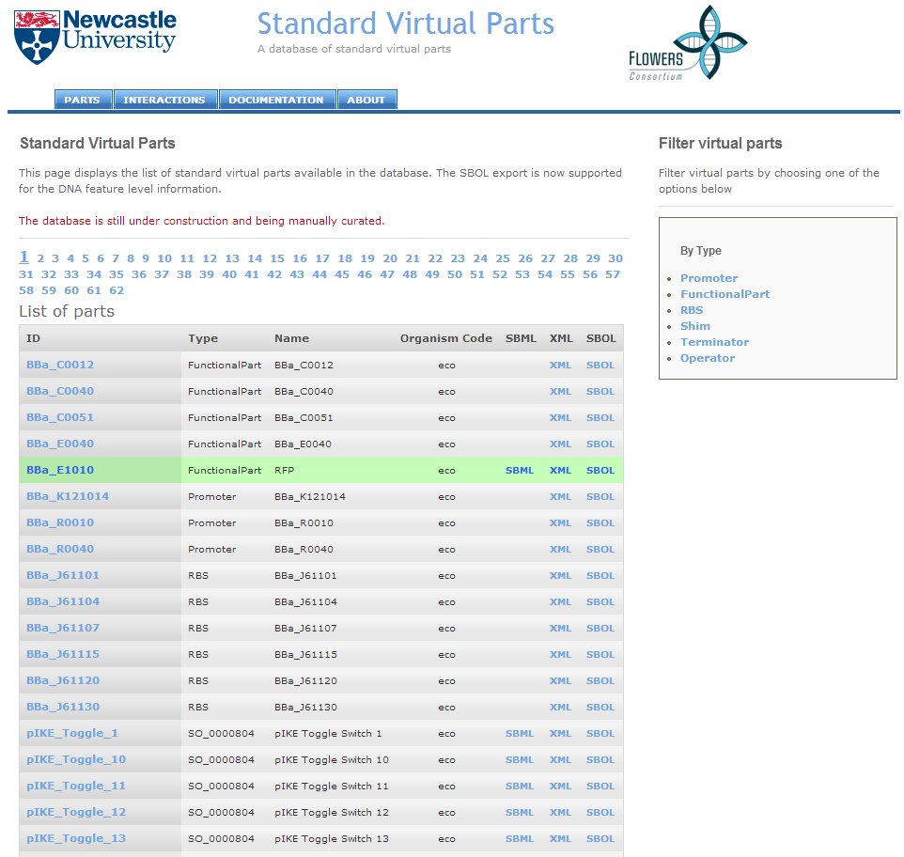
A repository of SVPs
http://www.virtualparts.org

Slide 8
Listening for new datasheets
New resource message:
Type : Datasheet
Uri : http://synbio.ncl.ac.uk:8081/system/FL_0000000001_characterisation
Name : spo0A
Description : spo0A promoter part
IMPERIAL COLLEGE
New Datasheet
Datasheet Registry
CAMBRIDGE
Flowers Messaging Infrastructure
(A cloud-based notification system)
EDINBURGH
New Datasheet Message
Datasheet
RSS
NEWCASTLE
Model Registry
A design tool

Slide 9
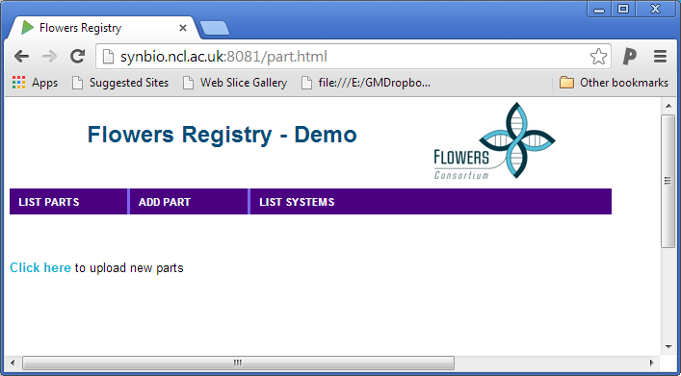
Demo

Slide 10
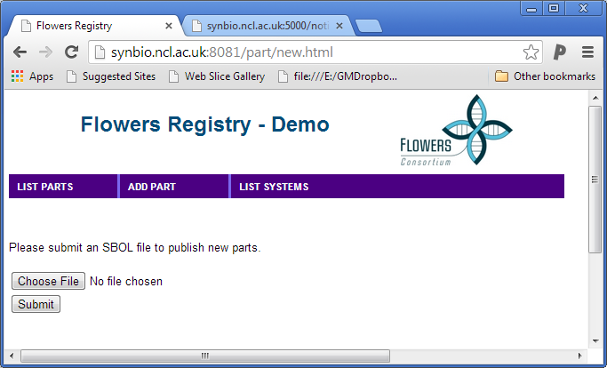
Demo: Upload an SBOL document

Slide 11
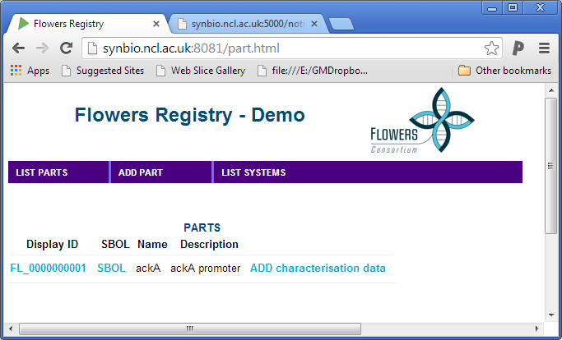
Demo: Upload a datasheet for the part

Slide 12
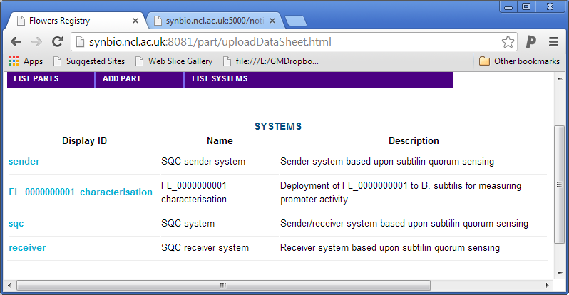
Demo: The datasheet is uploaded

Slide 13
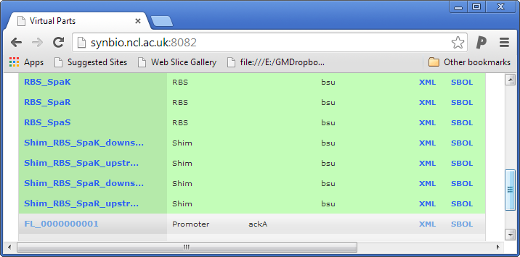
Demo: Model registry is updated with a new model

Slide 14
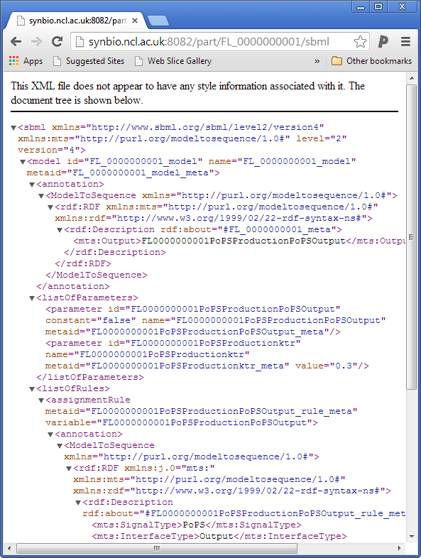
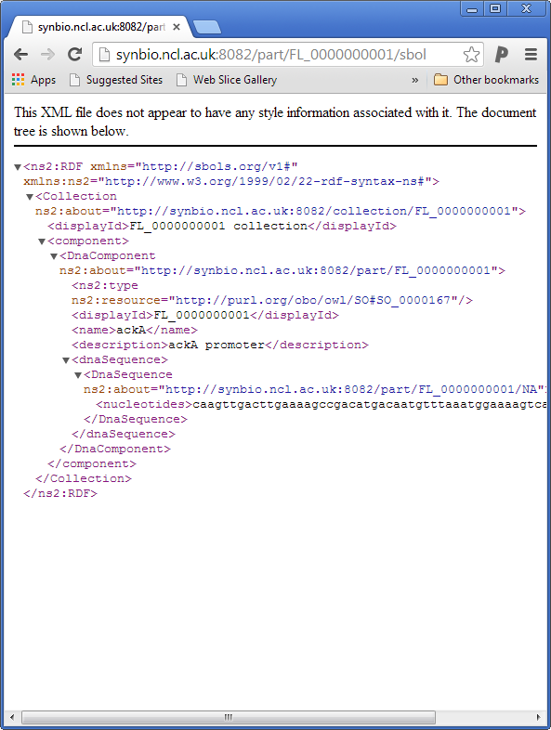
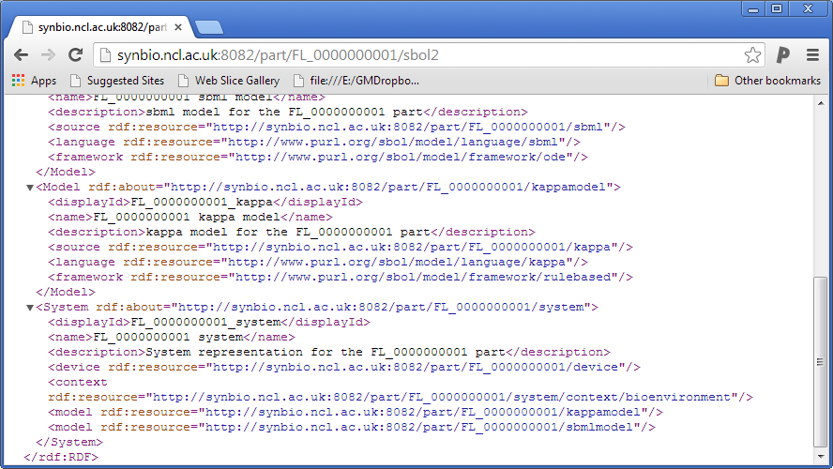
SBML
SBOL
SBOL Systems

Slide 15
What is next?
Develop SBOL Extensions APIs
libSBOLj System API 1.0 has been developed
Publicly available as a sub-project within the libSBOLj repository
Increasing the use of SBOL in the Flowers project
Closely working with Flowers partners at Imperial, Cambridge and Edinburgh

Slide 16
What is next for the community? Our wish list
We need to capture experimental data (from which models are derived)
Datasheets are currently not considered in SBOL
SBOL Performance extension can be incorporated back into the extensions
Experimental measurements of parts can be attached to systems
To capture context information
Measurements can be used by other tools to parameterise parts and create models

Slide 17
What is next for the community? Our wish list
Resources to unify the semantics
Resources to describe models
Model language: SBML, CellML, Kappa
Model framework: ODE, Rule-based
Describing context
Type information: Media type, cell type
Taxonomies?
We are also working on ontologies for the above

Slide 18


Thanks
Acknowledgements:
Prof. Anil Wipat
Dr. Jennifer Hallinan
Dr. Matthew Pocock
Dr. Keith Flanagan
Dr. Curtis Madsen
The Flowers consortium
SBOL developers

Slide 19
Listening for SBOL documents
Part Registry
NEW RESOURCE MESSAGE:
Type : Part
Uri : http://bacillobricks.co.uk/part/spo0A/sbol
Name : spo0A
Description : spo0A promoter part
New Part
Flowers Messaging Infrastructure
(A cloud-based notification system)
New Part Message
Part
RSS
Other Registries
Tool A

Slide 20
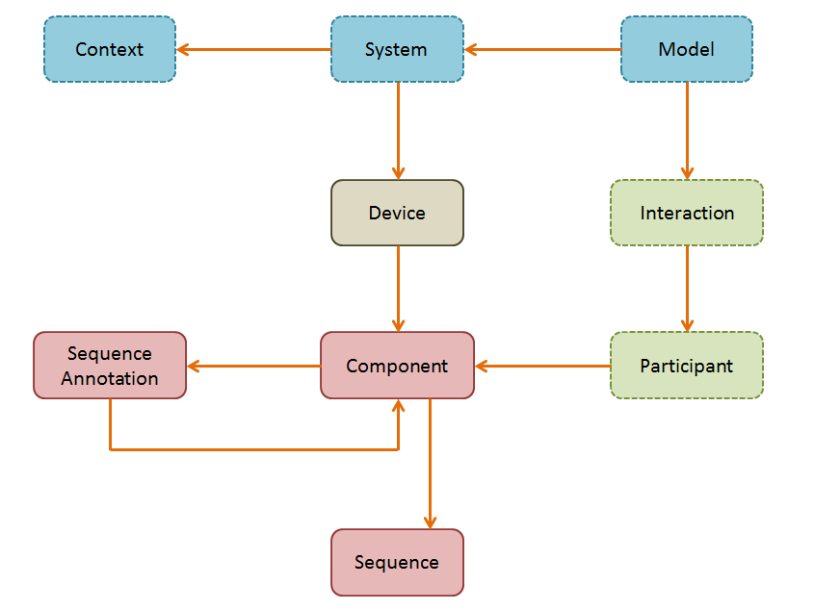
SBOL extensions

Slide 21
SBOL Systems extension
Described
uri
displayId
name
description
0..*
0..*
Context
System
Model
contexts
models
0..*
0..*
devices
subsystems
Device

Slide 22
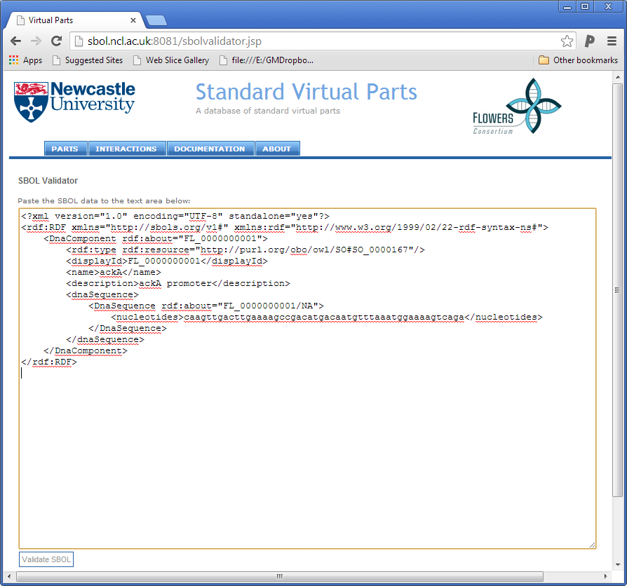
SBOL Compliance
SBOL support through libSBOLj
SBOL Visual through pigeonCAD
An online SBOL validator
It was very helpful during the SBOL exchange for the NBT paper
http://virtualparts.org/sbolvalidator.jsp
Validation is through libSBOLj
Not everything works according to the spec!

